Slide 1




Reinforcement Learning for Robotics
David Meger
Nov 19, 2019
COMP 417 – Intro to Robotics

Slide 2
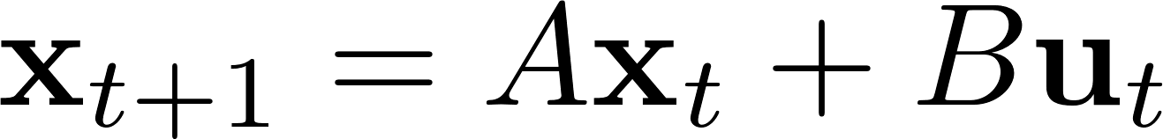
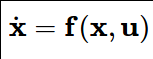
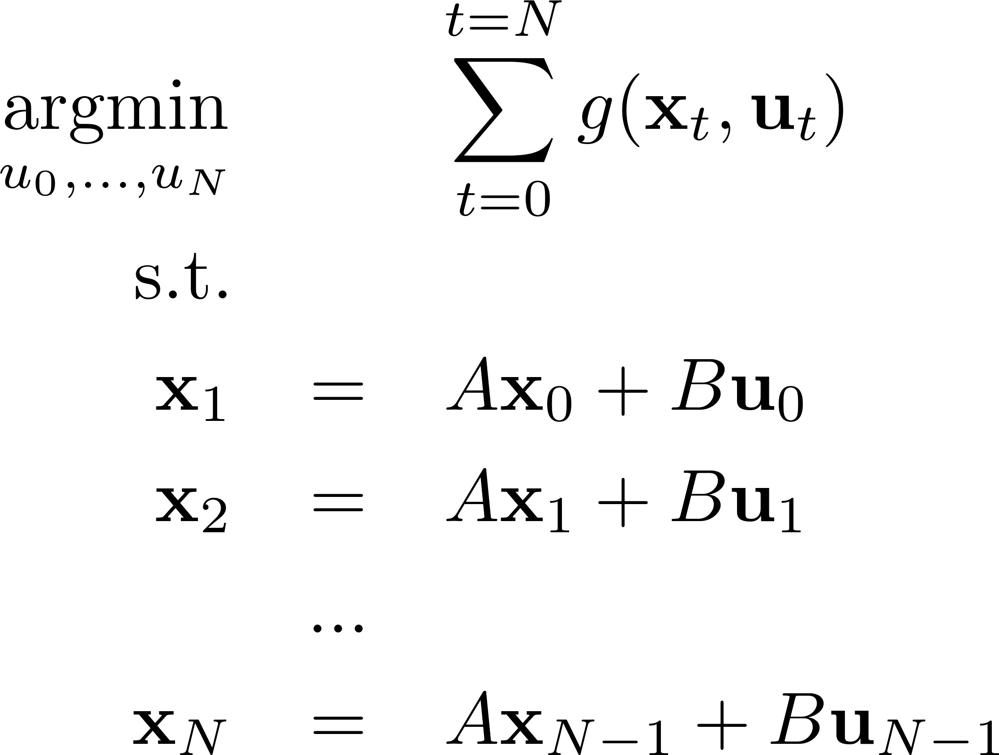
Where are we so far?
Optimal control gives us a good language for optimizing behavior:
LQR with nice guarantees under strict assumptions
Extensions in the bonus slides to extend this idea by linearizing
More ideas under the umbrella trajectory optimization
All of the above solve the optimal control constrained optimization assuming knowledge of both dynamics, f, and cost, g.
What if neither is known?

Slide 3
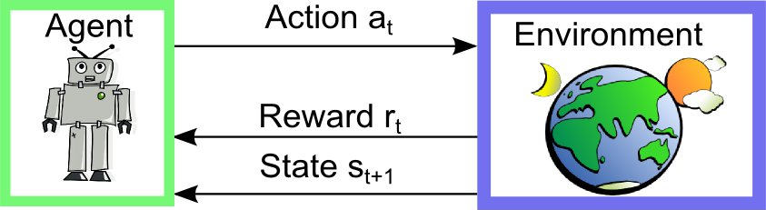
Reinforcement Learning

Slide 4
Reinforcement Learning
RL means learning by trial and error
Instead of typing in equations for f, A, B, Q, R, g etc, we assume the environment can give us these:
What is the f for a robot swimming with flippers?
We can guess it or compute crazy fluid dynamics, but we can more easily just observe its motions over time and use Machine Learning to derive a model
What is the g for winning ping pong?
This is difficult to write by math, but we can easily check the scoreboard during the game
We will switch from guaranteed, math-based reasoning to data-driven methods. Model on human development learning. Can we get “AGI”?

Slide 5
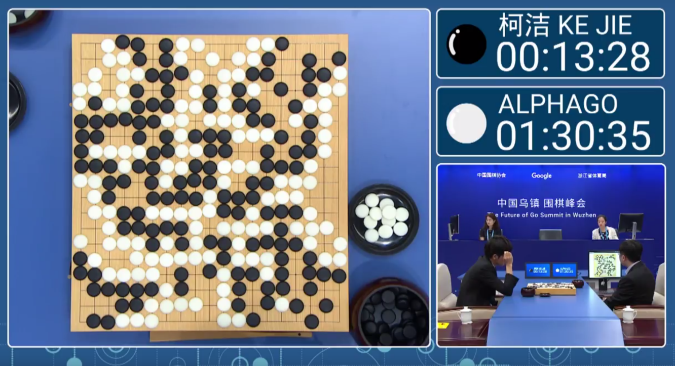
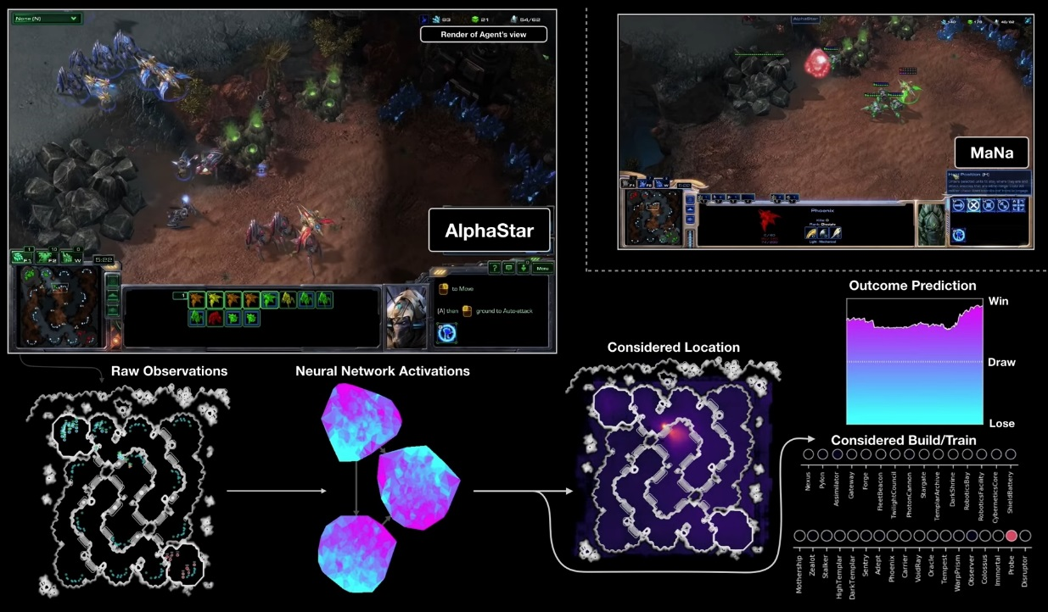
RL agents outperform humans!

Slide 6
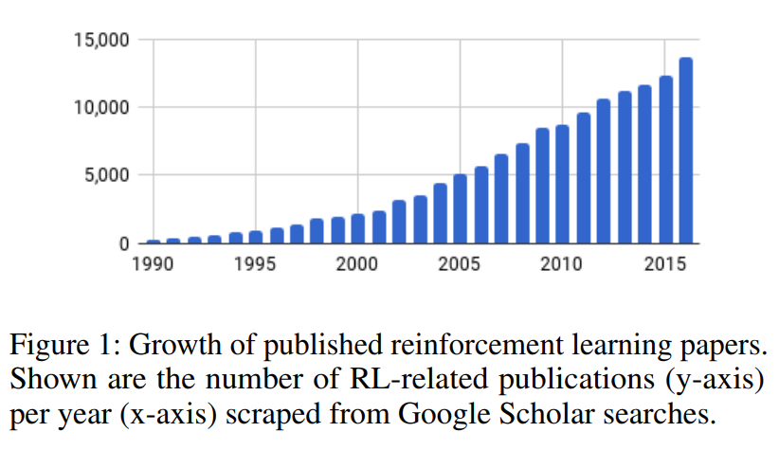

Slide 7
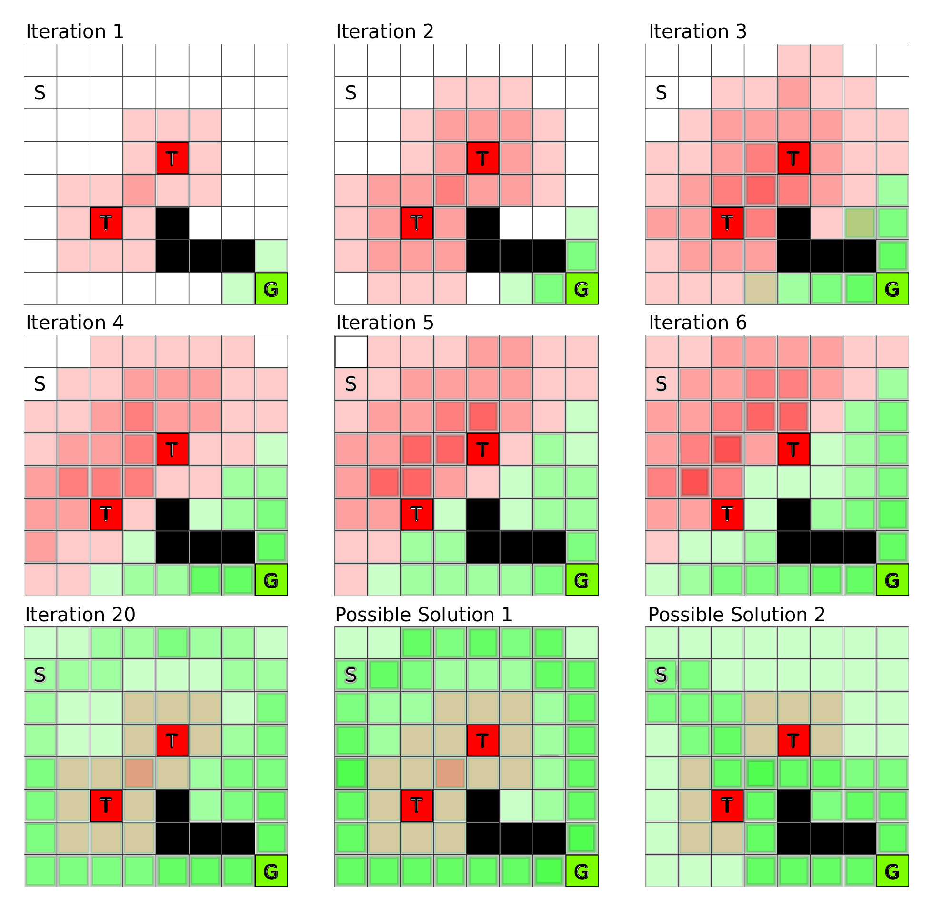
Value Iteration
Recall: Value means the expected discounted reward from here on
We saw that VI is dynamic programming that uses neighboring value estimate to capture “everything after the next step”
Value estimates guaranteed to converge as each gets sequentially closer to truth
Image credit: https://devblogs.nvidia.com/deep-learning-nutshell-reinforcement-learning/

Slide 8
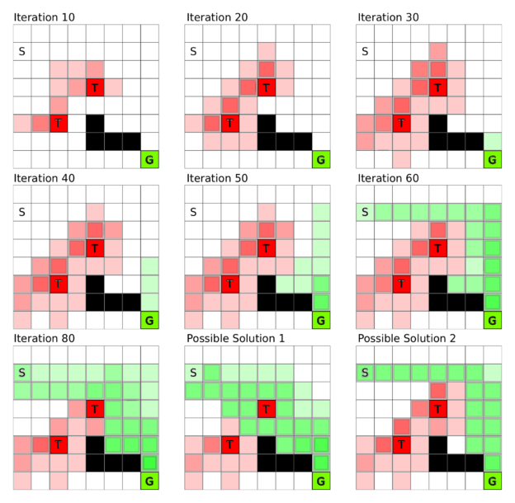
Q-Learning: Online
Now we must experience the world through exploration:
s,a,r,s’: being somewhere, taking an action, and observing where you end up plus reward
Use s,a,r,s’ to update Q values
$$Q\left(s,a\right)←r+γ\max_{a^{′}}{Q\left(s′,a′\right)}$$
[Watkins 1989] proves convergence with infinite data
Credit: https://devblogs.nvidia.com/deep-learning-nutshell-reinforcement-learning/

Slide 9
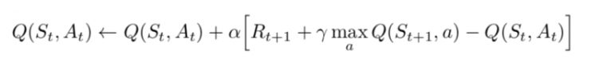
Deep Q Learning: The Engine behind Go, SC2, etc.
We learn a deep neural network to predict the action-value function:
This is a recursive equation, so similar to our DP table, for every data point observed, we update estimates based on neighbors. Over time, the estimate (hopefully) converges to accurately capture ”how good it is to be at state S and take action A”.
We can then apply control to the robot by taking the max over actions for the current state read by the sensors.
Notes:
In this work we look at a state of the art actor-critic method DDPG.
In DDPG the max operator has been replaced with a policy, which is optimized to maximize the Q function, with respect to the actions selected by the policy.
Even without an explicit maximization, overestimation can still occur due to the local maximization by gradient ascent.
We can observe the overestimation empirically in DDPG.
----
The deterministic policy gradient algorithm, which an application of the chain rule to maximize the Q function with respect to the actions selected by the policy.

Slide 10
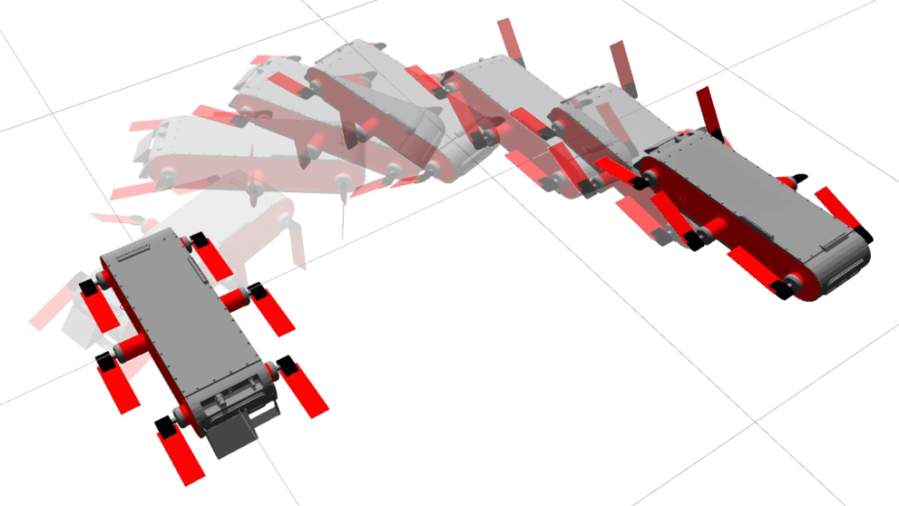



Unless RL works on robots, it’s not going anywhere – Tomaso Poggio < 2017

Slide 11
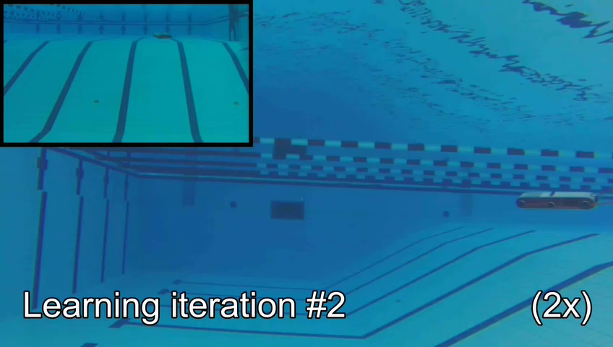
Gait learning on underwater robot
David Meger, Juan Camilo Gamboa Higuera, Anqi Xu, Philippe Giguere and Gregory Dudek. Learning Legged Swimming Gaits from Experience. ICRA 2015.
Notes:
Here’s an example of applying an algorithm that accounts for uncertainty, for a robot learning how to swim. In this example, the robot is attempting to swim forward, while rolling continuously, a barrel-roll maneouver.
At the beginning, with little experience, uncertainty is going to be high, leading to exploratory behaviour. But progressively, as its model makes better predictions, we can see the robot’s behavior approaching the correct one.
After just 8 iterations, the robot has successfully found a policy for the task, effectively learning a new motor skill.

Slide 12
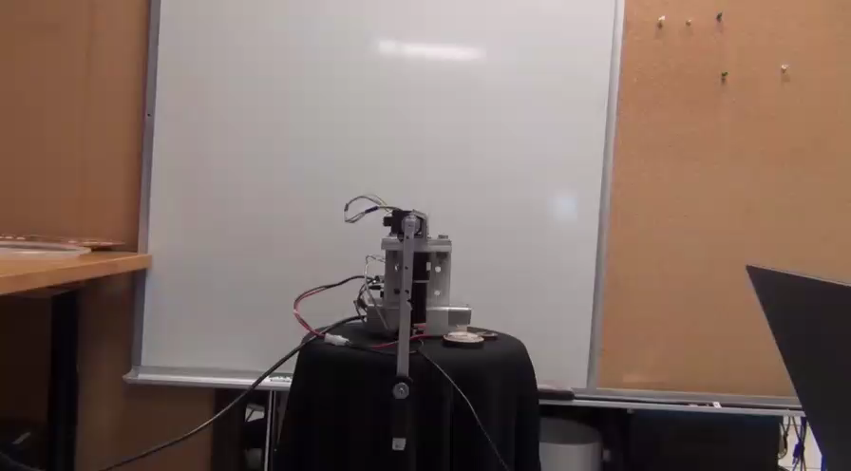
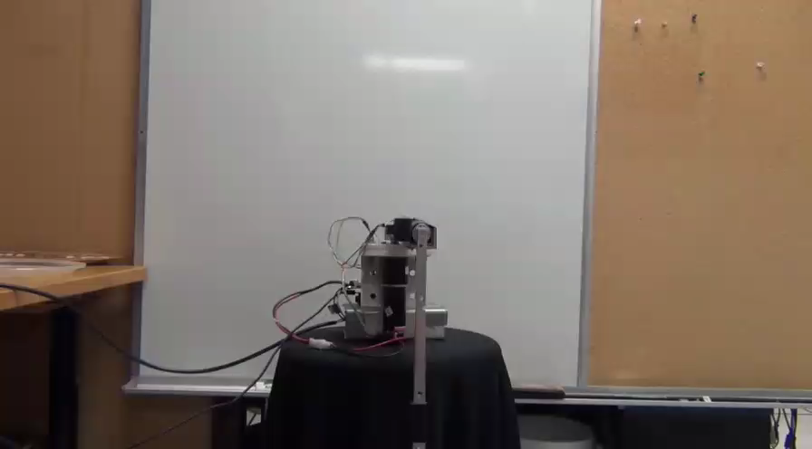
Transfer between cart-pole of varied mass
Added weight
12
Juan Camilo Gamboa Higuera, David Meger and Gregory Dudek. Adapting Robot Behaviours Through Policy Adjustments. ICRA 2017.
Notes:
To validate our approach, we ran some tests on the task of balancing an inverted pendulum on a mobile base
We first trained a controller on our cart-pole system
Then modified the dynamics by increasing the mass of the pole being balanced. Which makes the original controller fail at the first try. The policy adjustments algorithm is able to adapt pretty quickly to the changes in the dynamics produced by adding extra weight

Slide 13
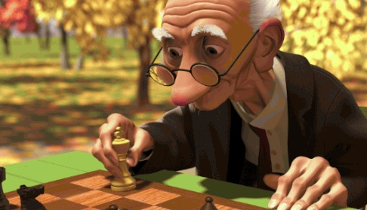

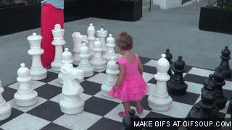
Discrete vs Continuous Value Functions
For discrete problems, there may be many actions, but at least we can track the outcome of each
For discrete problems, there may be many actions, but at least we can track the outcome of each
In continuous control problems, there are truly infinite outcomes at least stage, and the slightest differences may matter!

Slide 14
Continuous State/Action: Actor Critic
We replace the max operator with a policy $π$:
$$Q\left(s,a\right)←r+γQ′\left(s^{′},a^{′}\right), a^{′}\sim π′(s^{′})$$
The policy can be updated following the Policy Gradient:
$$∇J\left(π\right)=∇Q\left(s,a\right){\left.​\right|}_{a=π(s)}∇π(s)$$
$$π=π+α∇J(π)$$
Notes:
In this work we look at a state of the art actor-critic method DDPG.
In DDPG the max operator has been replaced with a policy, which is optimized to maximize the Q function, with respect to the actions selected by the policy.
Even without an explicit maximization, overestimation can still occur due to the local maximization by gradient ascent.
We can observe the overestimation empirically in DDPG.
----
The deterministic policy gradient algorithm, which an application of the chain rule to maximize the Q function with respect to the actions selected by the policy.

Slide 15
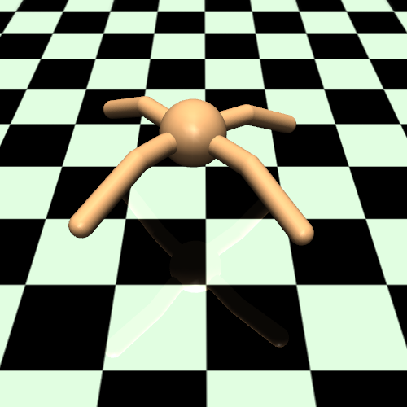
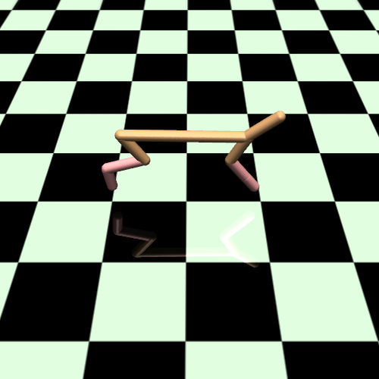
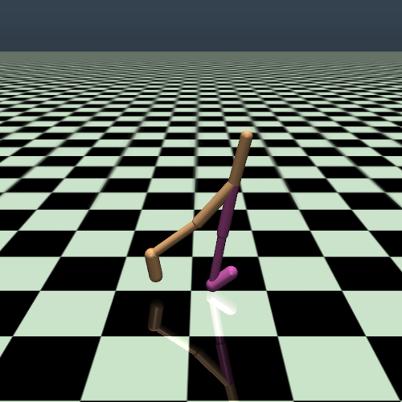
How to measure Deep RL for robots?
Standard “robot-like” evaluation is OpenAI Gym
Simple interface for a suite of benchmark tasks to measure progress

Slide 16
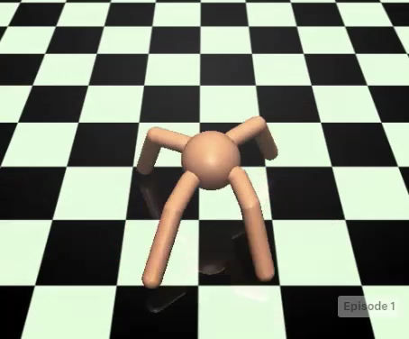
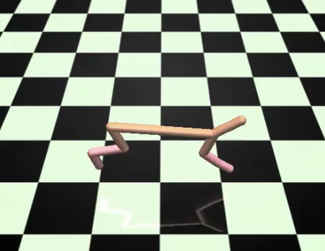
Learning Progress

Slide 17
Peter Henderson’s story
Began working on Method A, the most promising in Sept 2016
Same authors published Method B in Spring 2017
Paper results showed order of magnitude greater performance. “Method A is unable to solve the task, which our new idea tackles.”

Slide 18
Peter Henderson’s story
Began working on Method A, the most promising in Sept 2016
Same authors published Method B in Spring 2017:
Paper results showed order of magnitude greater performance. “Method A is unable to solve the task, which our new idea tackles.”
News articles announce “RL is approaching solved”

Slide 19
Peter Henderson’s story
Began working on Method A, the most promising in Sept 2016
Same authors published Method B in Spring 2017
Peter’s own code showed Method A and Method B performing equally
Better than the paper in both cases, through only trivial code fixes…

Slide 20
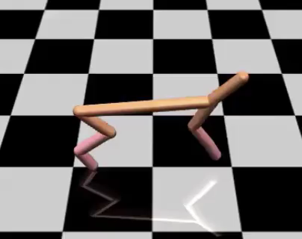
This was the performance at the time

Slide 21
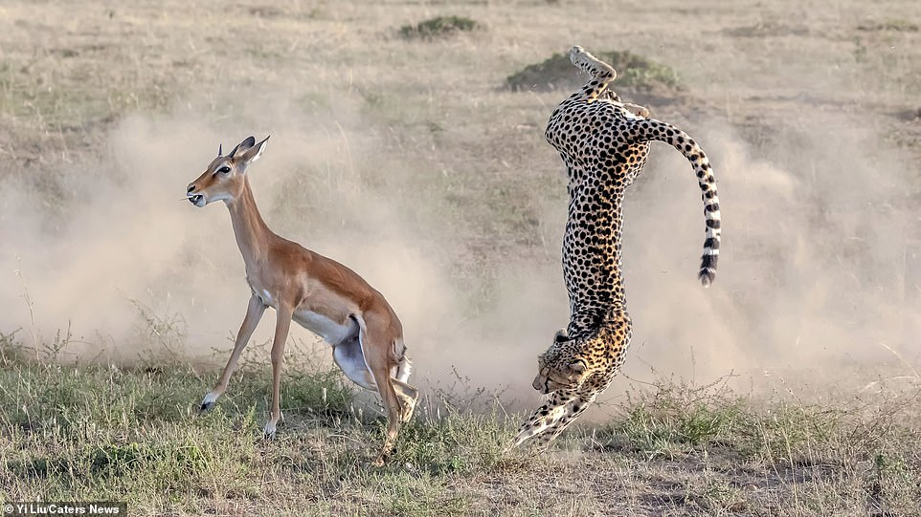

Slide 22
Wagstaff, “ML that Matters”, ICML 2012
“Much of current machine learning (ML) research has lost its connection to problems of import to the larger world of science and society. From this perspective, there exist glaring limitations in the data sets we investigate, the metrics we employ for evaluation, and the degree to which results are communicated back to their originating domains. What changes are needed to how we conduct research to increase the impact that ML has?”

Slide 23
Henderson et al, “Deep RL that Matters”, AAAI 2018
What factors lead to lack of reproducibility in Deep RL approaches?
Which of the existing method comparisons are meaningful? Develop actual statistical testing for A vs B RL comparisons.
Are there “right” ways to do experiments in this domain?

Slide 24
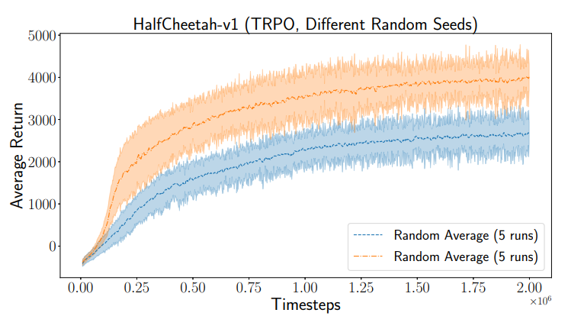
A significant improvement!

Slide 25
This is the same method run twice, only changing the random seeds…

Slide 26
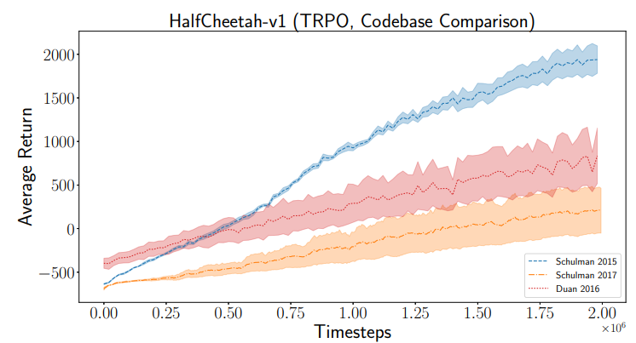
Another winner!

Slide 27
These are implementations of the
same paper, mostly by the same coders…

Slide 28
Method choice rarely outweighs “nuisance” factors
Random seeds:
Initial policy weights
Exploration actions
Hyper parameters:
Batch size
Learning rate
Reward scaling
Network architecture, activations, normalization

Slide 29
We know these shouldn’t matter!
Reporting the max over many trials while hiding the mean and variance
Allowing an optimizer to select the best random seed
Reporting the score of only a single random trial or a very small set of repetitions

Slide 30
Outcomes
We recommend experimental practices that have started to change how methods are evaluated.
More transparency about how repeated trials and seeds are handled
Must show tables with hyper parameter values
Must not optimize hyper parameters for each individual task. This is the RL equivalent of training on the test set
It is not OK to hide variance – this must be addressed in the techniques
ML conferences now request “Reproducibility Checklist” as standard publication practice. Motivated by our findings and similar.

Slide 31
Problem: Many papers state “Our experiments follow the recommendations of [Henderson2018].”
Fewer papers actually follow the recommendations, and it takes significant reviewer effort to verify.
Peter is carrying out a follow-on study using to confirm this.

Slide 32
How many of these same practices and findings apply to robotics experiments?

Slide 33
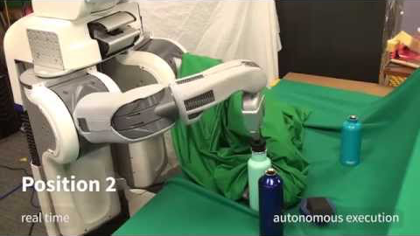

Slide 34
Part 2: Improving DRL stability by diving deep on value learning

Slide 35
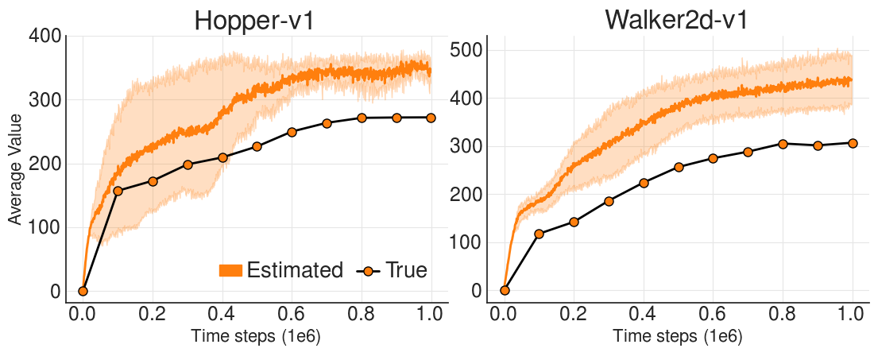
Empirical truth: values are overestimated
Notes:
In this graph we're examining the estimated value in orange, against the true value in black.
There is a clear overestimation.
So what can we do about this?
One of the first things I was taught in machine learning was to use a validation set, independent of the training set.
We do this to get a better estimate of the accuracy of our methods because we overfit to training error.
----------------------------------------
But of course it should come to no surprise to you that this overestimation occurs just the same in DDPG, a state of the art deep actor-critic method.
Even without greedy maximization, overestimation can still occur due to the local maximization by gradient descent.

Slide 36
Why Overestimated when we had proofs?
[Watkins 1989] proves convergence of Q-Learning with infinite data… however…
This did not account for the types of errors neural networks make.
It only worked in the discrete action case or for ”linear function approximation”
Credit: https://devblogs.nvidia.com/deep-learning-nutshell-reinforcement-learning/

Slide 37
Continuous State/Action: Actor Critic
We replace the max operator with a policy $π$:
$$Q\left(s,a\right)←r+γQ′\left(s^{′},a^{′}\right), a^{′}\sim π′(s^{′})$$
The policy can be updated following the Policy Gradient:
$$∇J\left(π\right)=∇Q\left(s,a\right){\left.​\right|}_{a=π(s)}∇π(s)$$
$$π=π+α∇J(π)$$
Notes:
In this work we look at a state of the art actor-critic method DDPG.
In DDPG the max operator has been replaced with a policy, which is optimized to maximize the Q function, with respect to the actions selected by the policy.
Even without an explicit maximization, overestimation can still occur due to the local maximization by gradient ascent.
We can observe the overestimation empirically in DDPG.
----
The deterministic policy gradient algorithm, which an application of the chain rule to maximize the Q function with respect to the actions selected by the policy.

Slide 38
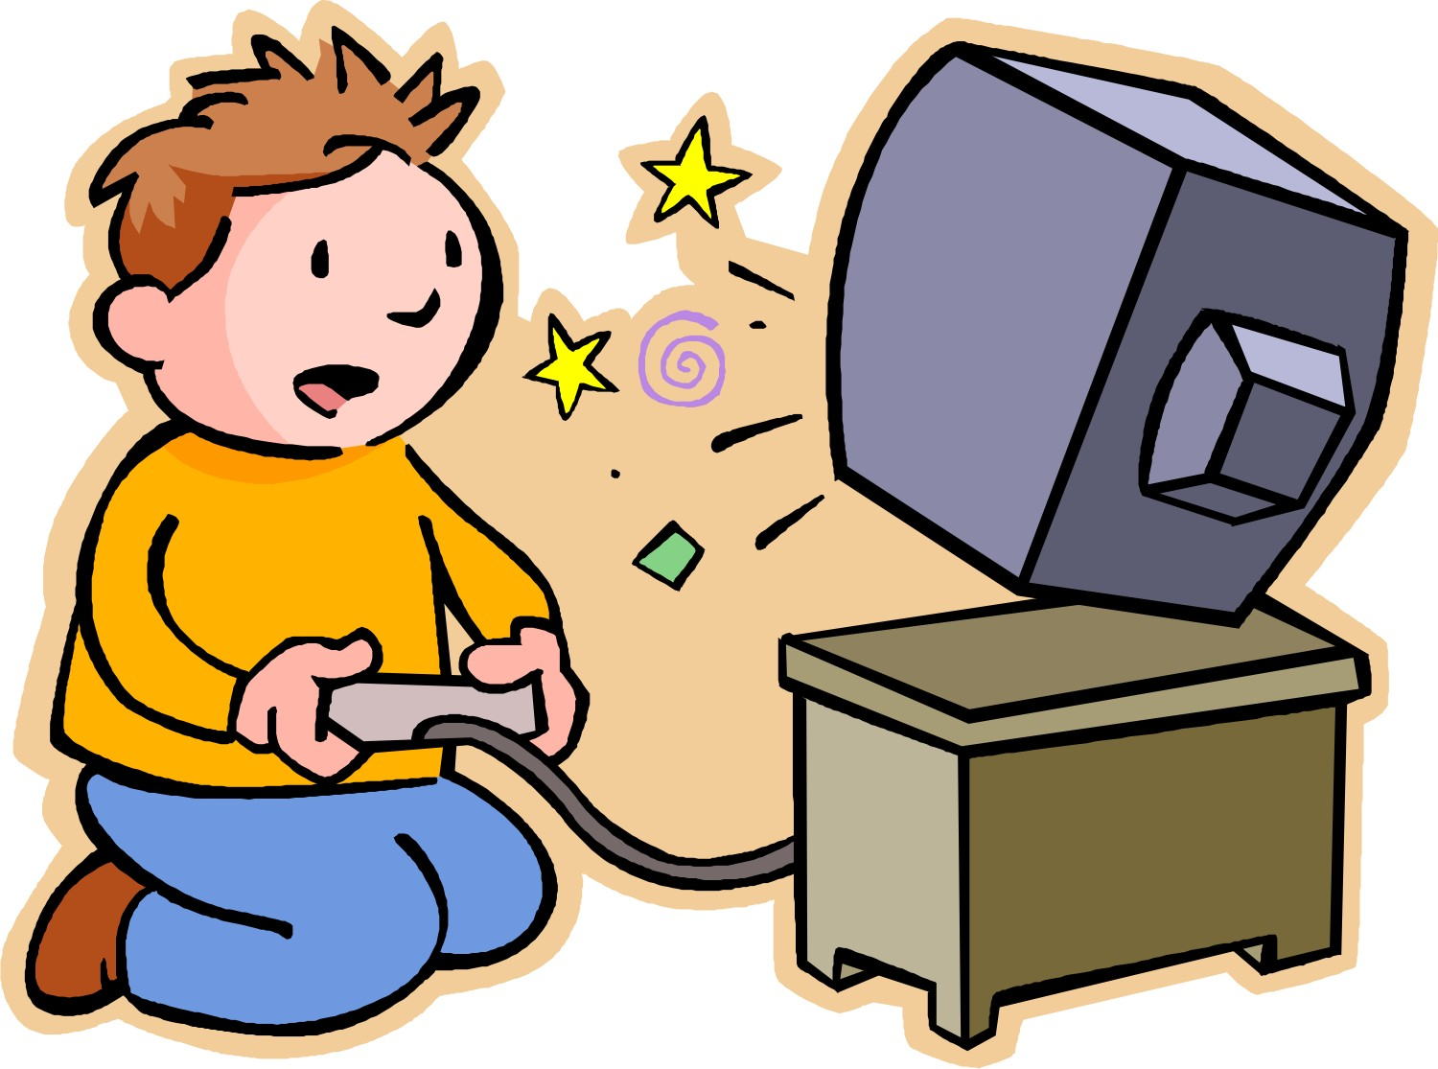
Scott’s story
Notes:
So what is overestimation bias?
When I was young, I used to play a lot of video games, and a lot against my older brother.
And since we were brothers, he was the person I played against the most.
And one thing that I thought at the time was, if I can beat my brother, I'll be able to beat all of my friends.

Slide 39
Notes:
Sadly this was often not true, because my brother played differently than my friends,
and my ability to beat my brother, was only an approximation of my ability of to beat my friends.
Ultimately, I was overfitting my estimation of how good at video games I was, to my ability to beat my brother.

Slide 40
Goodheart’s Law
When a measure becomes a target, it ceases to be a good measure.
High interest rate means growing economy?
Most lines of code means best programmer?
Highest RL value estimate means best action?
Only if we do not allow “gaming the system”
Notes:
In reinforcement learning, we call this overconfidence, overestimation bias.
Which in other words means: you will overfit the metric you optimize with respect to.

Slide 41
Stare at the update rule of Q-learning with discrete actions. Remember Q is a neural network that starts with random weights:
$$Q\left(s,a\right)←r+γ\max_{a^{′}}{Q\left(s′,a′\right)}$$
With errors $ε$ overestimation is likely to occur (Thrun & Schwartz, 1993) (even if error is initially unbiased!)
$$Ε\left[\max_{a^{′}}\left(Q\left(s^{′},a^{′}\right)+ε\right)\right]>Ε\left[\max_{a^{′}}{Q\left(s^{′},a^{′}\right)}\right]$$
Notes:
Specifically, in value-based reinforcement learning, our agents optimize with respect to a learned Q-function, taking a max operator over a discrete set of possible actions.
If this metric, our approximate value, does not correspond exactly with the true metric, the true value,
we will overfit to the approximate value and overestimate the true value.
This can result in the propagation of overestimated values and suboptimal action selection.
This has been well-studied in a discrete action setting. But never in an actor-critic setting with continuous actions.
-----
Just like I thought I could beat my friends at some video game because I could beat my brother,
our agents can pick sub-optimal actions because they over-value their ability to achieve rewards when selecting that action, due to errors in their estimation.

Slide 42
Actor Critic is also expected to over-estimate
Recall the Policy Gradient learning updates:
$$Q\left(s,a\right)←r+γQ′\left(s^{′},a^{′}\right), a^{′}\sim π′(s^{′})$$
$$∇J\left(π\right)=∇Q\left(s,a\right){\left.​\right|}_{a=π(s)}∇π(s)$$
$$π=π+α∇J\left(π\right)$$
We are the first to show the gradient is expected to choose the an action that over-estimates when Q has noise
Notes:
In this work we look at a state of the art actor-critic method DDPG.
In DDPG the max operator has been replaced with a policy, which is optimized to maximize the Q function, with respect to the actions selected by the policy.
Even without an explicit maximization, overestimation can still occur due to the local maximization by gradient ascent.
We can observe the overestimation empirically in DDPG.
----
The deterministic policy gradient algorithm, which an application of the chain rule to maximize the Q function with respect to the actions selected by the policy.

Slide 43
Double Q-Learning: Known for discrete MDP
A strategy for reducing overestimation bias is to use two independent estimates of the value function (van Hasselt, 2010):
$$Q_{1}←r+γQ_{2}^{′} (s′,π_{1}^{′})$$
$$Q_{2}←r+γQ_{1}^{′} (s′,π_{2}^{′})$$
In Double DQN, the target network $Q_{1}^{′}$ is used as one of the estimates (van Hasselt et al., 2015):
$$Q_{1}←r+γQ_{1}^{′} (s′,π_{1})$$
(Double Q-learning)
(Double DQN)
Notes:
In reinforcement learning, we apply the same idea in a technique called Double Q-learning.
This works by using two independent value functions and estimating the value of the policy derived from each value function through cross-validation.
This was designed for a tabular setting, so in a deep-RL setting, we use Double DQN, where one of the value functions is replaced by the target network.
Now both of these were originally for discrete actions,
so we converted both of these to an actor-critic format, by combining them with DDPG, to see how well they reduce overestimation.
But we found these methods didn’t work as well as they did in their original format.

Slide 44
Clipped Double Q-learning
We propose a novel learning target, Clipped Double Q-learning:
$$Q_{1}←r+γ\min{(Q_{1}^{′}\left(s^{′},π_{1}^{′} \right),Q_{2}^{′}\left(s^{′},π_{1}^{′} \right))}\underset{INV}{\underbrace{()}}$$
If $Q_{1}$ generally overestimates, we can upper-bound the less biased $Q_{2}$ by the biased $Q_{1}$
This eliminates the situation where $Q_{2}>Q_{1}>Q_{true}$
Notes:
So to counter-act this, we introduce clipped double q-learning, where we take the minimum between the two critics in Double Q-learning.

Slide 45
Clipped Double Q-learning
We propose a novel learning target, Clipped Double Q-learning:
$$Q_{1}←r+γ\min{\underset{Standard}{(\underbrace{Q_{1}^{′}\left(s^{′},π_{1}^{′} \right)}}, \underset{Double}{\underbrace{Q_{2}^{′}\left(s^{′},π_{1}^{′} \right)})}}\underset{INV}{\underbrace{()}}$$
If $Q_{1}$ generally overestimates, we can upper-bound the less biased $Q_{2}$ by the biased $Q_{1}$
This eliminates the situation where $Q_{2}>Q_{1}>Q_{true}$
Notes:
This corresponds to either taking the standard Q-learning update or the double q-learning update.
The idea being, if Q1 generally overestimates we never want Q2 to be greater than Q1.
So let's clip the value of Q2 by Q1, which corresponds to taking the minimum.
If we have two biased estimates, we should be pessimistic about the true value.

Slide 46
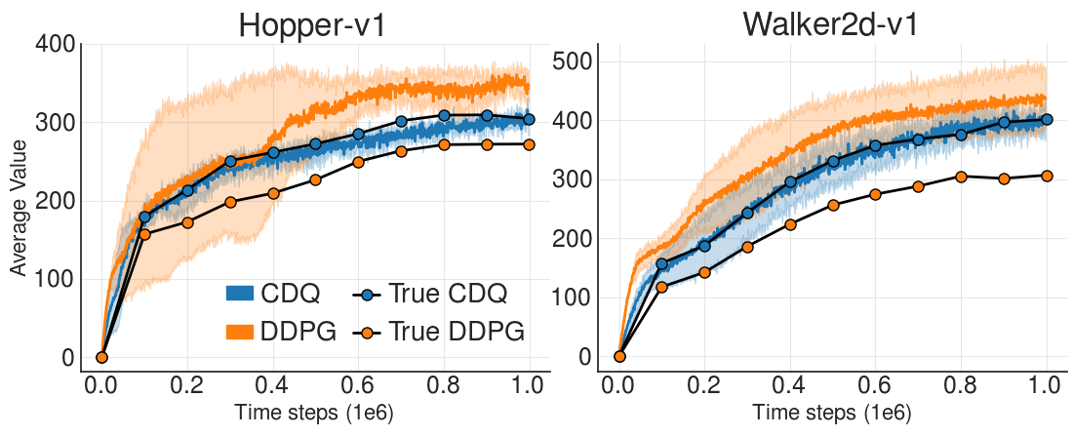
Clipped Double Q-learning
Notes:
And it turns out this works really well.
Our method is in blue, against DDPG in orange. We've greatly reduced the overestimation.
However, this doesn’t mean our value estimation is perfect,
just that we have decorrelated the errors from the maximization bias.
It is important to note that even uncorrelated errors can cause suboptimal action selection.
So now we’ll look at the root cause of overestimation bias: the noise induced by function approximation errors.
----
If these errors were small, overestimation wouldn’t be a big problem.

Slide 47
Twin Delayed DDPG (TD3)
Clipped update and several other modifications are added to DDPG to form Twin Delayed Deep Deterministic policy gradient (TD3).
$$Q_{1},Q_{2}←r+γ\min\left(Q_{1}\left(s^{′},a^{′}\right),Q_{2}\left(s^{′},a^{′}\right)\right), a^{′}\sim clip\left(π\left(s^{′}\right)+ε, −c,c\right)$$
The actor and both target networks are updated every $d$ time steps.
Notes:
We combine all of this with DDPG to form Twin Delayed DDPG, TD3.
Taking the minimum between two critics, adding noise to the target policy, and only updating the actor every d timesteps.

Slide 48
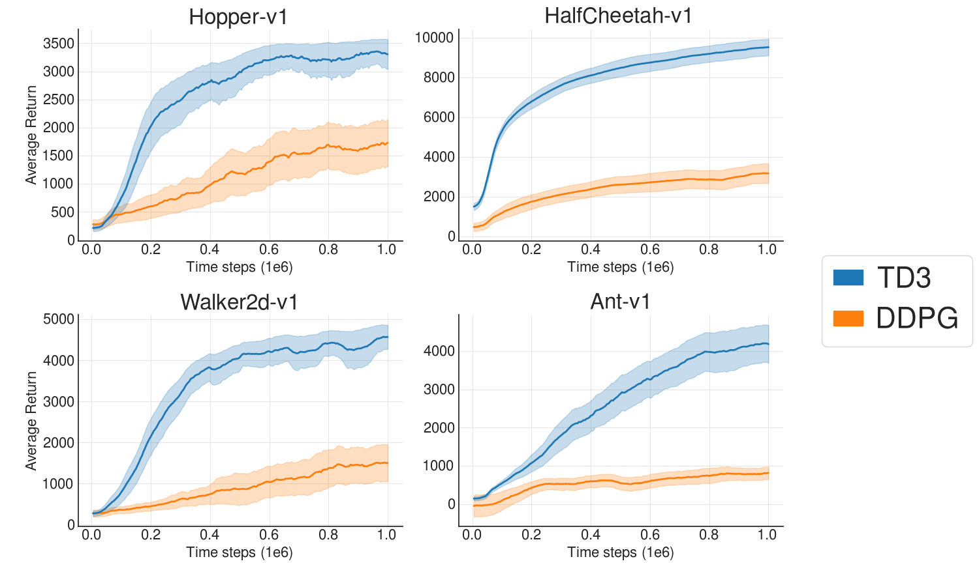
TD3 vs DDPG
Notes:
And it turns out, you can get really awesome results doing this.
On the OpenAI gym MuJoCo benchmarks, we greatly outperform several other state of the art algorithms such as DDPG, here in orange, with ours in blue.

Slide 49
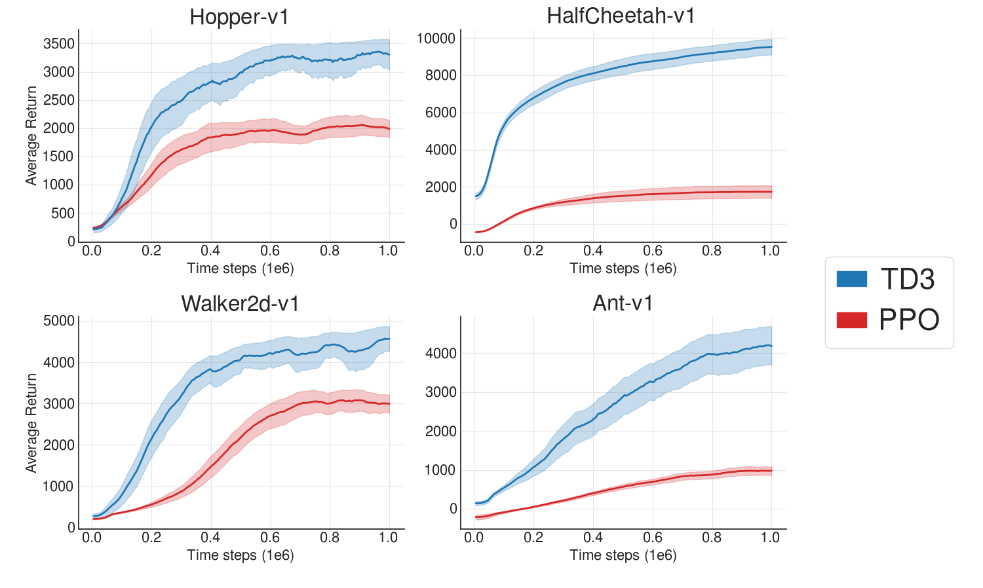
TD3 vs PPO
Notes:
And against PPO, in red

Slide 50
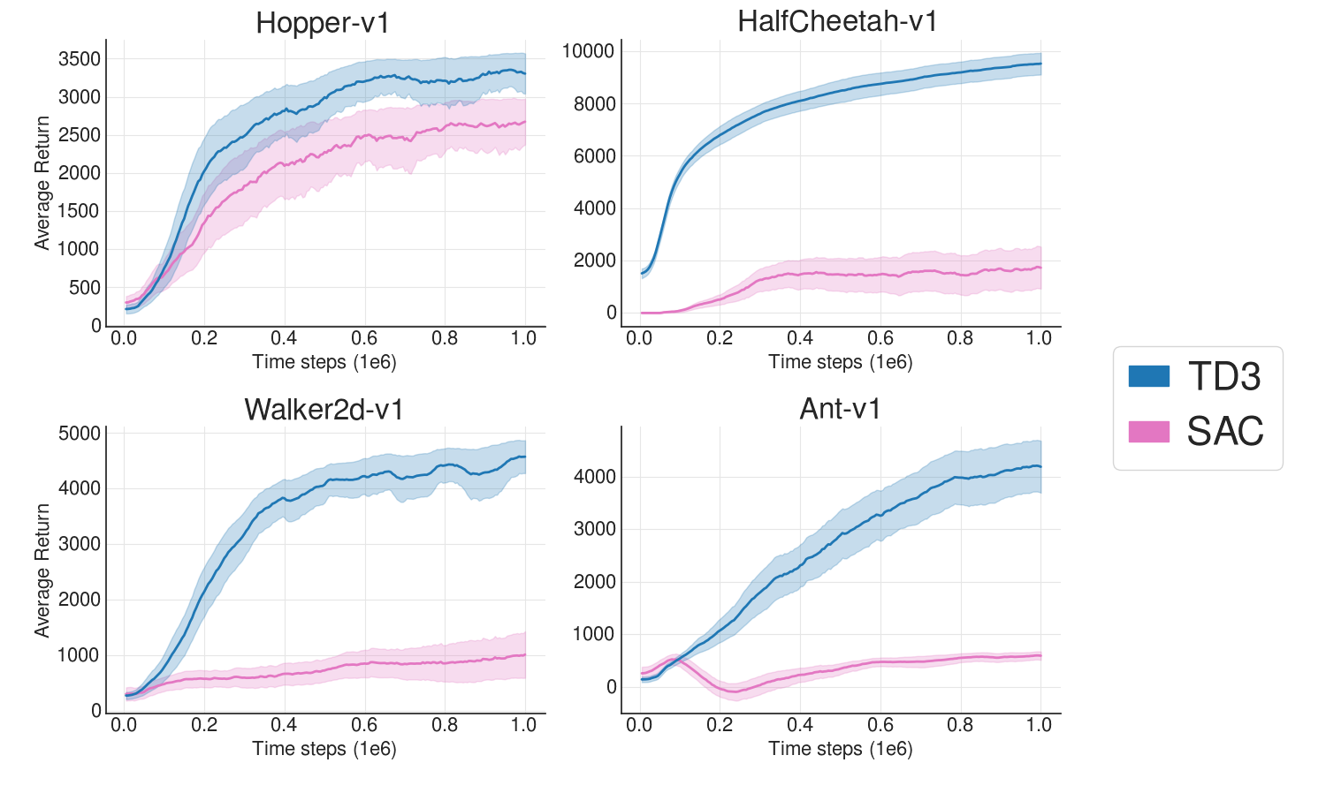
TD3 vs SAC* (*prior to TD3-SAC)
Notes:
And Soft actor-critic in pink

Slide 51
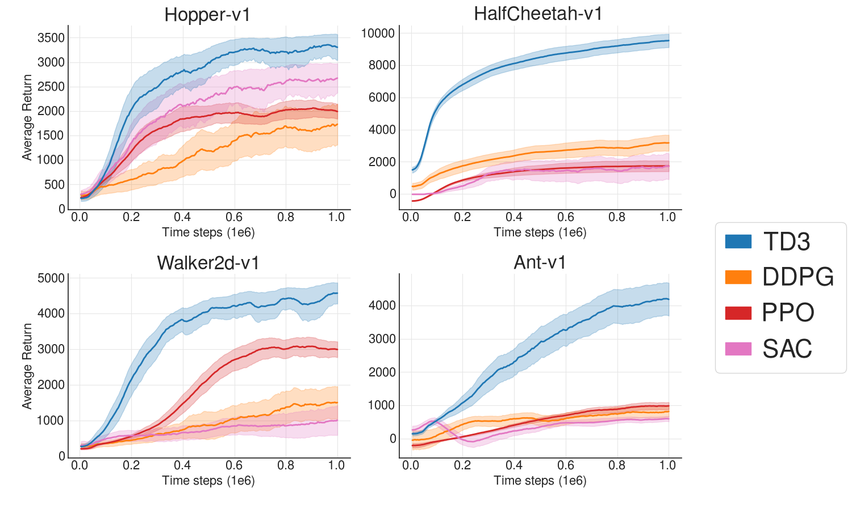
Results

Slide 52

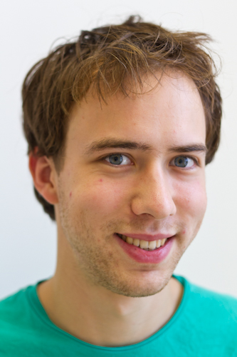
Take-home
You will overfit to the metric you optimize with respect to.
Overfitting occurs in actor-critic methods.
Pessimism in the value function can improve performance.
A new perspective on the importance of target networks:
Target networks reduce the buildup of error, which is critical when combined with a recursive maximization operation.
Updating the policy less can actually improve performance.
Use TD3! https://github.com/sfujim/TD3
Under 200 lines of PyTorch code with comments.
Scott Fujimoto
Herke van Hoof
Scott Fujimoto, Herke van Hoof and David Meger. Addressing Function Approximation Error in Actor-Critic Methods. ICML 2018.
Notes:
To summarize, some take-aways from this presentation:
You will overfit to the metric you optimize with respect to. Overfitting occurs in actor-critic methods. And correcting it can greatly improve performance.
Target networks are important because they reduce the buildup of error, we found this was critical when combined with the recursive maximization in Q-learning.
Updating the policy less can actually improve performance.
And finally a sales pitch.
Use our algorithm! The code is online with comments.
It's short and simple, and if you want to get into deep RL for continuous control, I would argue this is the easiest way.
Thank you so much for listening.

Slide 53


Conclusions
Improving continuous value estimates
The Batch RL problem
Batch-Constrained deep Q-learning (BCQ)
Value-based methods give the strongest theoretical guarantees and show such power in discrete tasks, they should be our hammer
Big improvements possible by acknowledging the practical considerations of real RL use, especially for continuous tasks
Quite promising to combine these ideas with transfer, Sim2Real, etc!
All honor to these collaborators, especially Scott Fujimoto, a current PhD at MRL and MILA
Scott Fujimoto
Herke van Hoof
Doina Precup

